Slide 1
Regional Entrepreneurship & Innovation Strategy + Implementation
VLGMA - April 14, 2021

Slide 2
Entrepreneurship and Economic Development

Slide 3
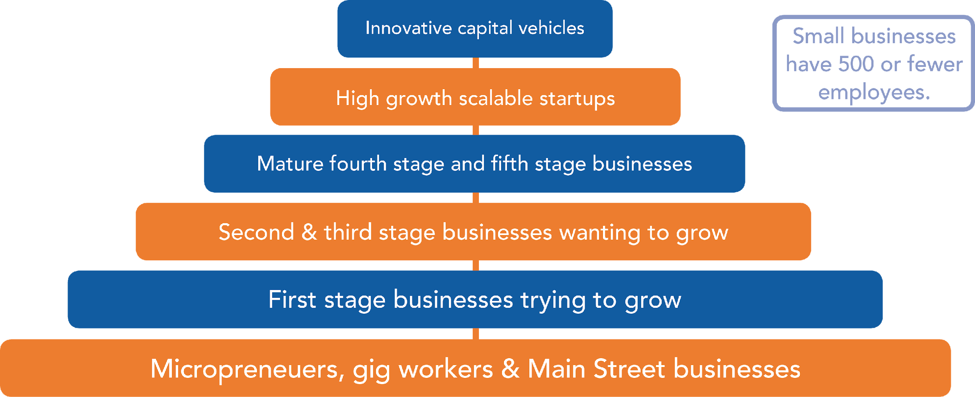
An entrepreneur is anyone who takes risk on a venture.

Slide 4
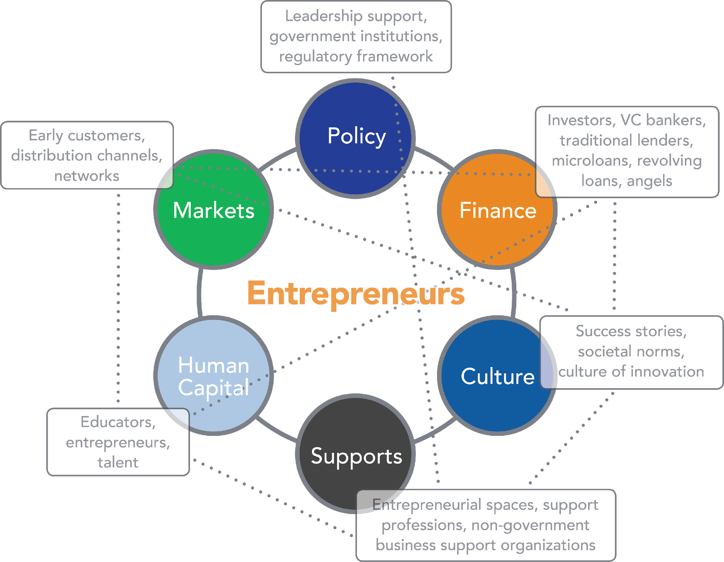
An ecosystem approach:
“Entrepreneurial ecosystems refer to the human, financial and professional resources and institutional environment which support and nurture new ventures in a specific geographic location…”
Local government plays an important role!

Slide 5
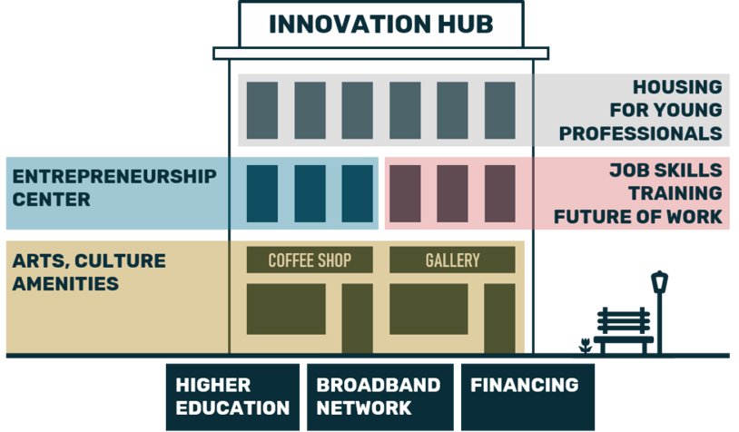
How it comes together at the local level…

Slide 6
Contact Information
Lauren Mathena, Mid-Atlantic Broadband
lauren.mathena@mbc-va.com
Sheri McGuire, Longwood University
mcguiresr@longwood.edu

