Slide 1
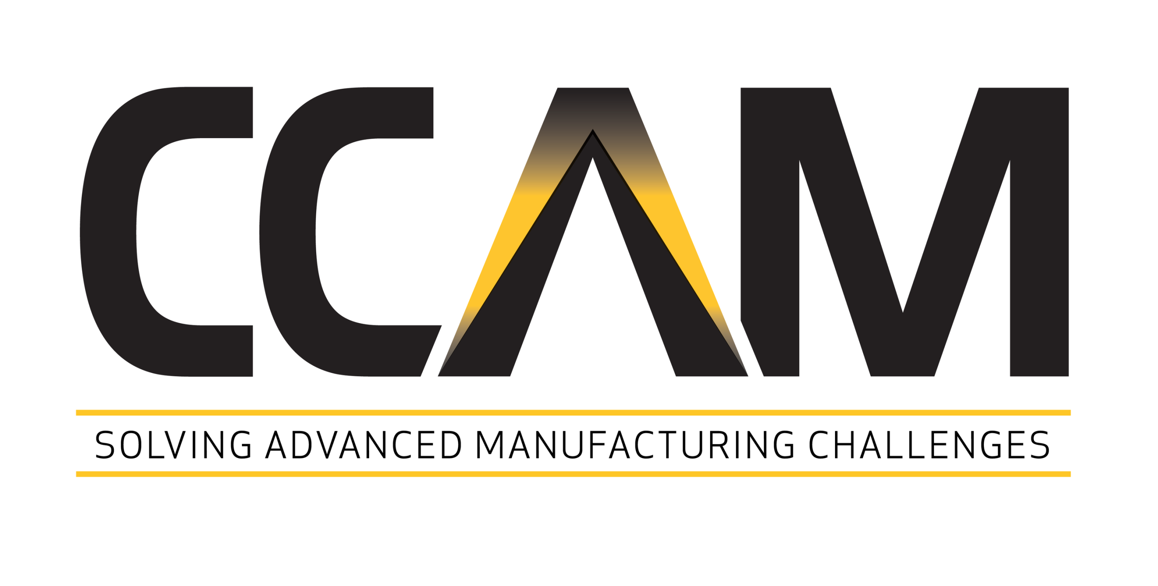

Slide 2
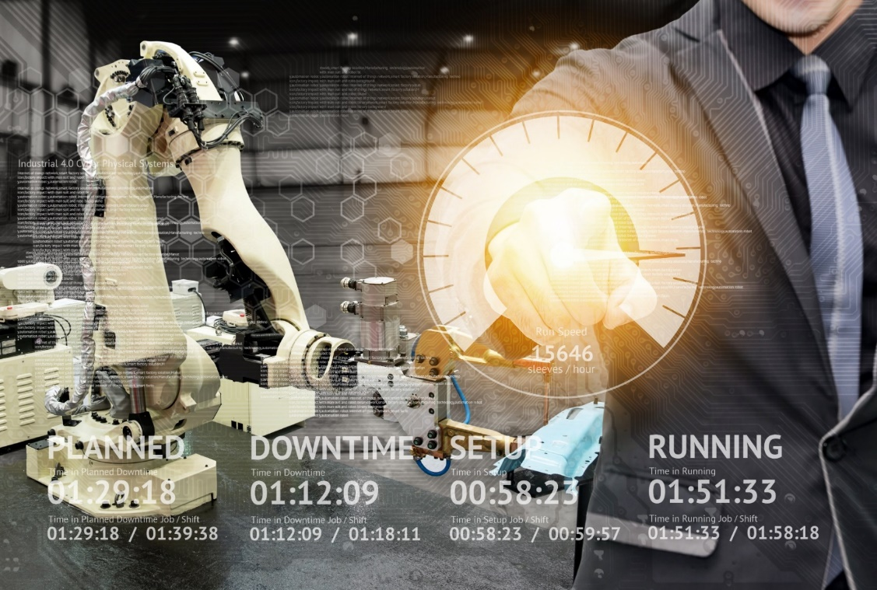
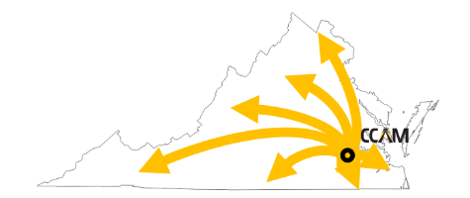
A Regional Partner: The Commonwealth Center for Advanced Manufacturing
CCAM solves your Challenges
You own the Intellectual Property
Take advantage of the most unique IP model in industry
Partner with industry leaders and top research universities
Leverage incentives from government agencies
Collaborate with world class engineers and technicians to develop new technologies
“Through our membership with CCAM, we gain access to high-quality research and a collaborative environment to support our current and future products."
Vice President, Research & Technology for Airbus
Develop real intelligence about your business & manufacturing processes to impact your competitiveness
Notes:
With CCAM’s unique IP model in collaboration with Fortune 100 company members, 5 research University partners, and active government entities, CCAM’s world class engineers and technicians can help you apply and integrate the latest manufacturing technologies for your business. We focus on process so you can deliver for your customers.

Slide 3
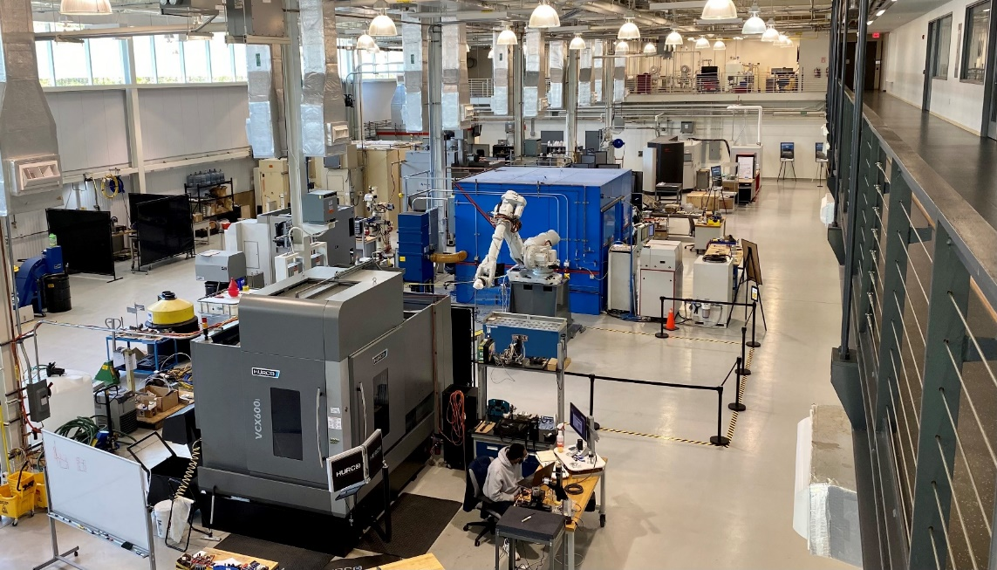
Joining the CCAM Consortium Saves Costs and Increases Revenue
For the cost of one R&D employee, leverage knowledge that our >30 experienced applied manufacturing researchers have built up across multiple disciplines – and – access faculty, labs, & students at five outstanding research universities
Instead of creating one test bed or disrupting your production equipment and team, build process intelligence in our 16,000 ft² high bay or labs equipped with state of the art equipment and software
Get fast bottom-line results by safely and securely collaborating with our industry, academic and government members
Capitalize on State incentives and access Federal grants to leverage your investments and achieve your goals – confidently, economically, and efficiently
Contact: Lorin.Sodell@ccam-va.com

Slide 4
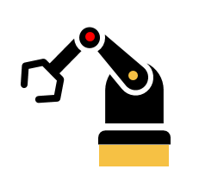
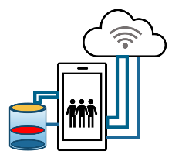
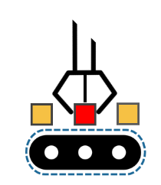
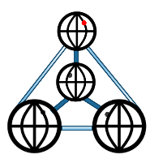
CCAM Adds Intelligence to Your Business Operations
In today’s competitive market, businesses are driving to be more distributed, automated, and intelligent
CCAM can help you build process intelligence, starting with direct data capture, to open new insights that will improve quality while increasing productivity and efficiency, with:
Automation
Flexible
Manufacturing
IIOT
Sensing and Data Capture
Manufacturing
Process Expertise
Machine
Learning
Materials
Engineering
From business or manufacturing process design through execution, CCAM works with a range of industries across aerospace, defense, pharma, automotive, consumer goods, & many more
CCAM’s success is measured by your ROI

Slide 5
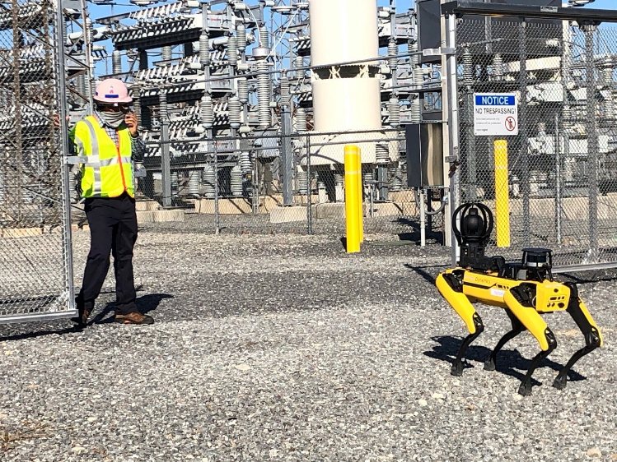
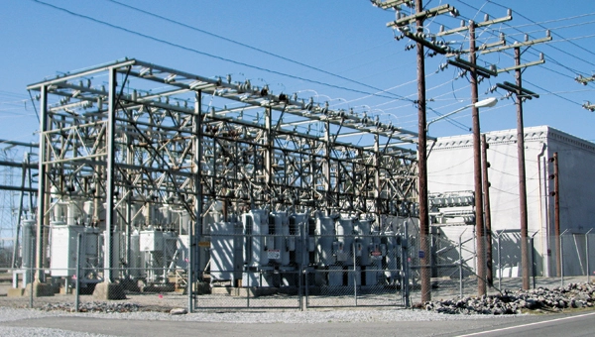
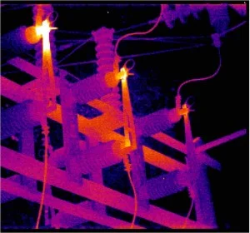
Examples of how CCAM’s Technologies can help an organization
Technology demonstration / proof of concept projects that integrate emerging technologies to improve:
Safety
System reliability
Technician and Engineering productivity
Examples Include:
Autonomous infrared thermography in substations
“Leading indicator” sensor integration into key substation components
Automated equipment condition feedback to improve switching safety
IIOT
Sensing and Data Capture
Automation
Machine
Learning

Slide 6
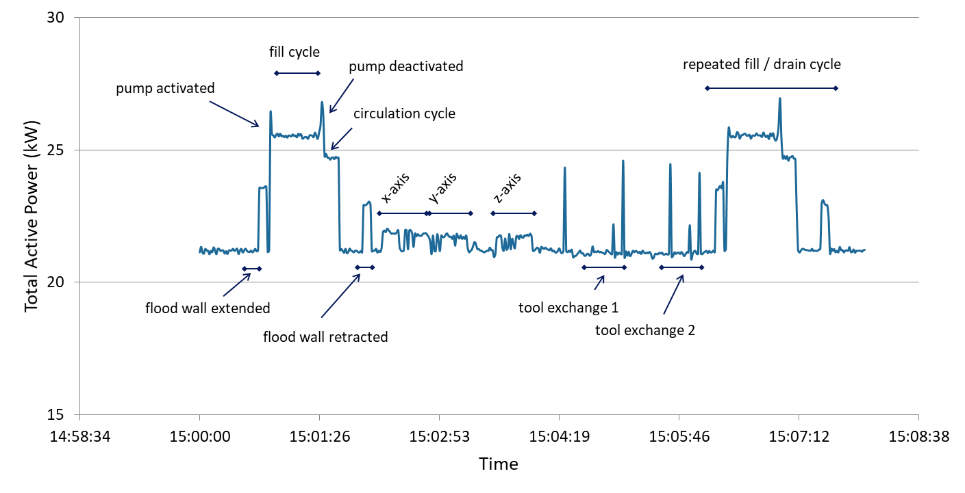
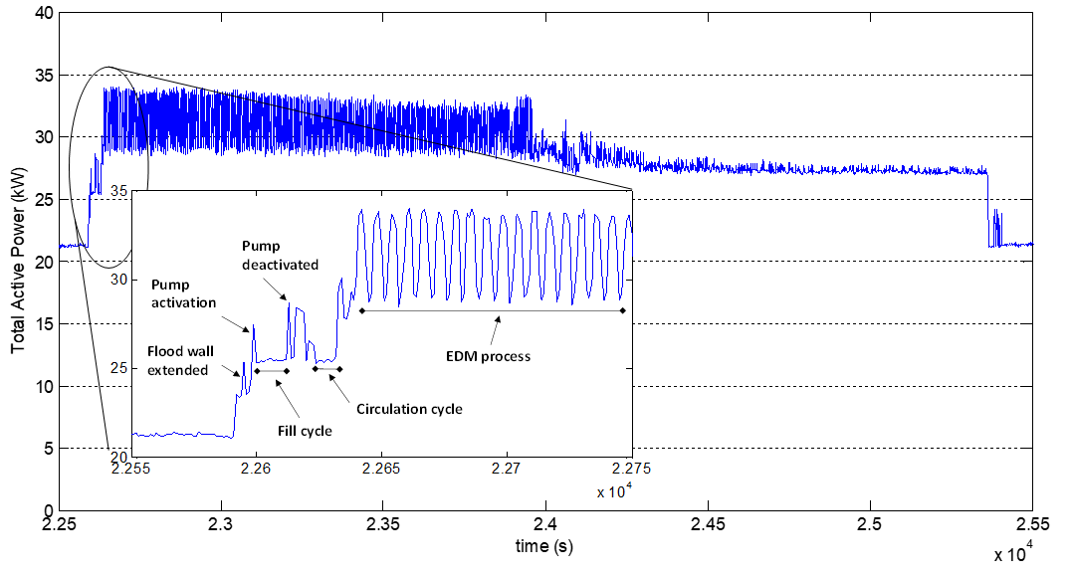
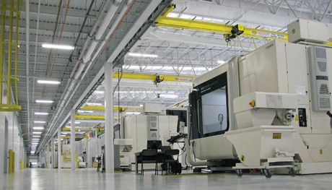
Examples of How CCAM’s Technologies Help our Members Improve Their Businesses
Mapping of a facility’s energy usage (aggregate and individual equipment)
Correlation of power consumption to operational activities
Analytical tools to reduce peak power consumption
Demonstration of technologies at CCAM, using our equipment, to help companies safely power-down and power-up equipment to minimize waste
CCAM is a CESMII – Smart Manufacturing Institute member where we integrate intelligence into energy conservation
Notes:
Classify or differentiate the machine tasks within a power profile
So we collected a ground truth data with a series of specified tasks
Each sub operation has a unique signature so it becomes easy to decouple them from the entire power profile

Slide 7
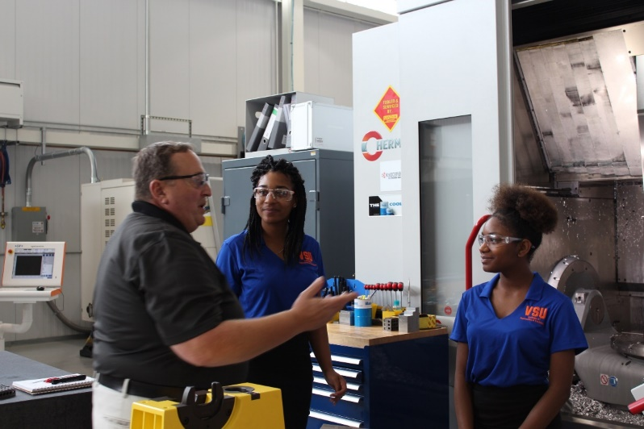
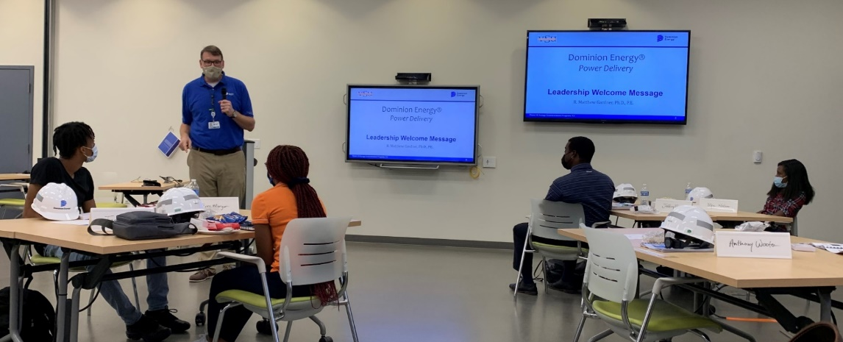
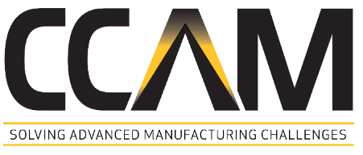
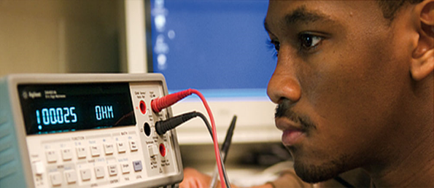
Integration of Systems Learning with Partners at VSU, VCU and more
Internship Program and Training
Advanced Diagnostic and Analytical Tools
Students and Curriculum Integration
Interns from CCAM member universities work on real world member projects
Collaborative internships provide a conduit for undergrad students to gain the career skills they’ll successfully apply after graduation

Slide 8
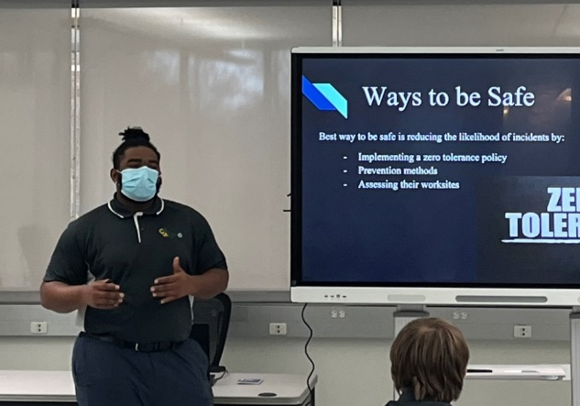
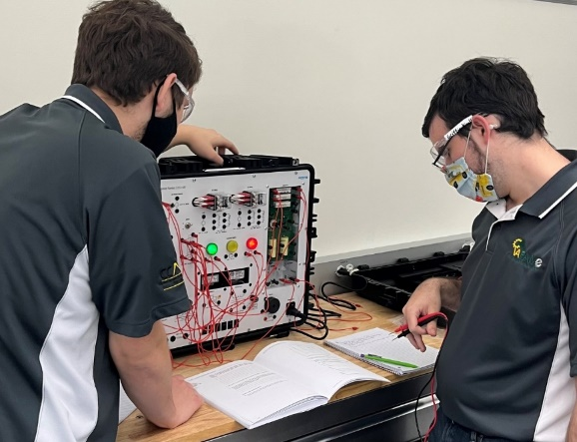
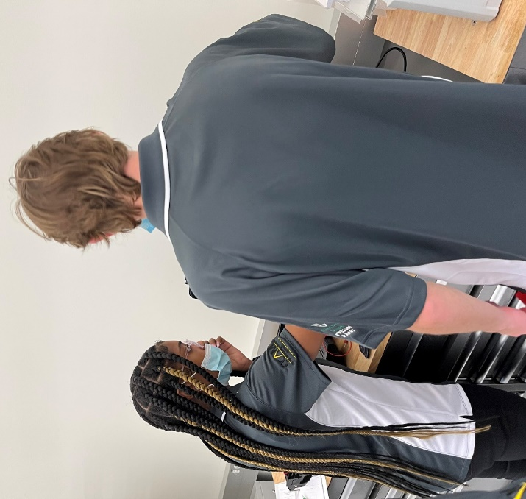
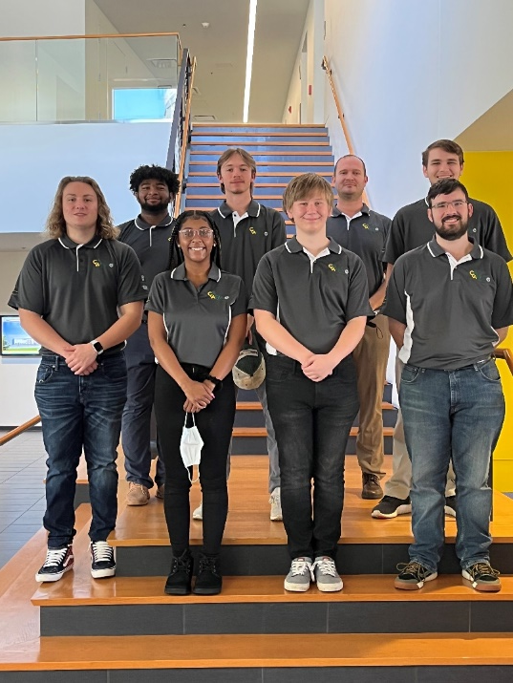
The FAME Model in Action at CCAM
Learning Already Integrated with Employment at CCAM Through FAME
7 Students are currently enrolled in Central VA FAME, employed by industry Core Members
Using the CCAM facility and equipment as a real-time learning lab for their careers
Participants work ~24 hours / week at their sponsoring employers and attend classes 2 days / week at CCAM & RBC

