Slide 1
Economic Conditions
Renee Haltom
Vice President and Regional Executive
April 16, 2021
Research Department
Federal Reserve Bank of Richmond
The views and opinions expressed herein are those of the author. They do not represent an official position of the Federal Reserve Bank of Richmond or the Federal Reserve System.

Slide 2
The Upshot: Recovery is well underway
We’re still far from recovering COVID losses
Specifically, jobs are lagging
But strong growth on the horizon in 2021
(That is, barring unforeseen virus developments)
Strong consumption, housing, manufacturing
But what level does each sector recover to?
Inflation is the thing to watch
And lots of disparity (by sector, race, gender, income)
2

Slide 3
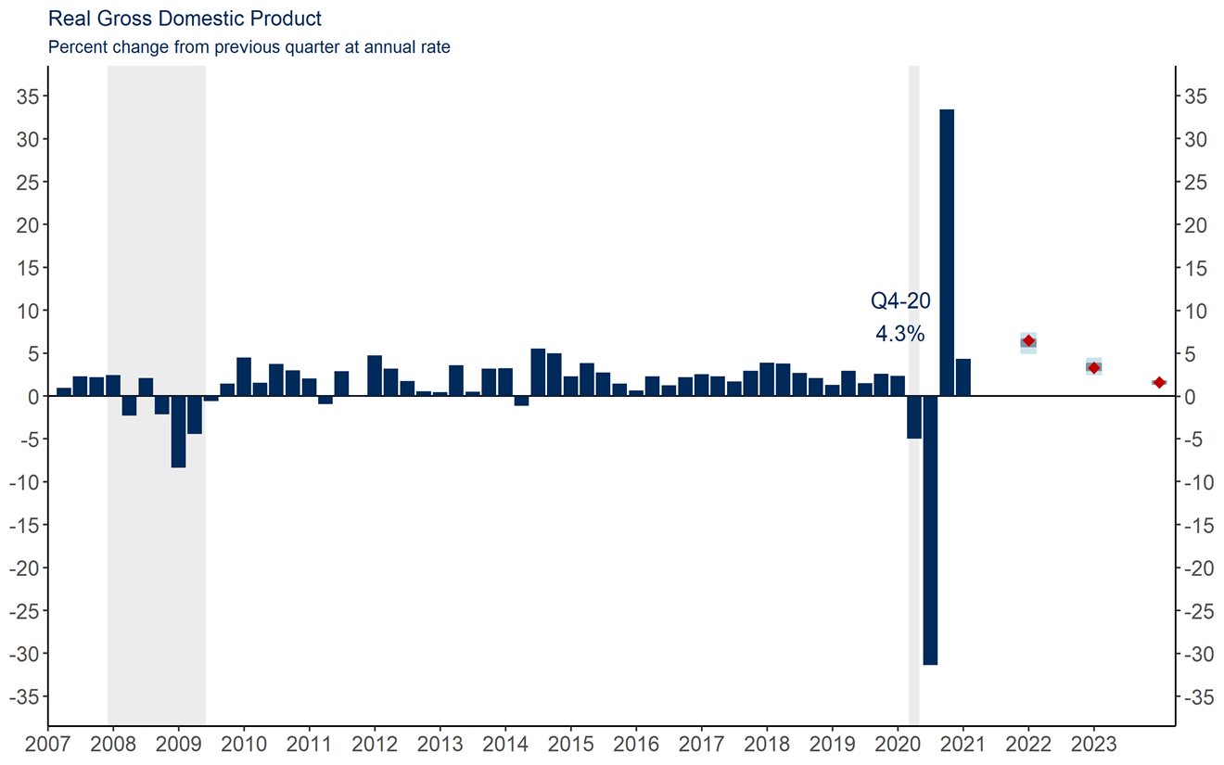
GDP recovery has been stronger than expected
FOMC projections (as of 3/17)
Source: Bureau of Economic Analysis via Haver Analytics
Notes: FOMC projection is the median, range, and central tendency for Q4/Q4 percent changes, from the March 2021 meeting. Red dots indicate median projections.

Slide 4
When swings are big, the level tells you more
Source: Bureau of Economic Analysis

Slide 5
Spending on services hit hard, and still far below pre-COVID
Source: Bureau of Economic Analysis via Haver Analytics

Slide 6
We’re producing as much as pre-Covid – but with 8.4m fewer workers
Monthly Change (in thousands):
March 21: 916
February 21: 468
January 21: 233
December 20: -306
November 20: 264
October 20: 680
September 20: 716
August 20: 1,583
July 20: 1,726
June 20: 4,846
May 20: 2,833
April 20: -20,679
March 20: -1,683

Slide 7
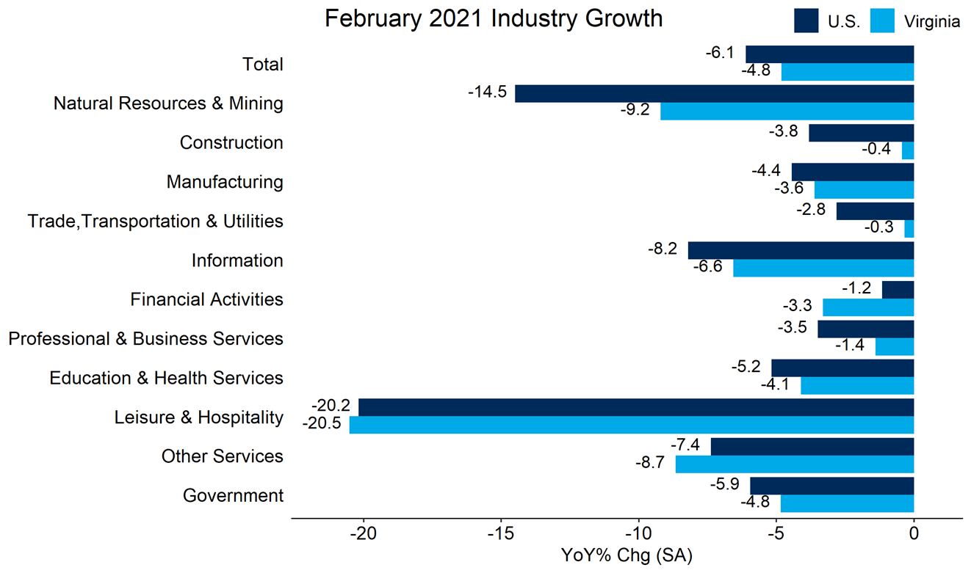
Some sectors hit much harder

Slide 8
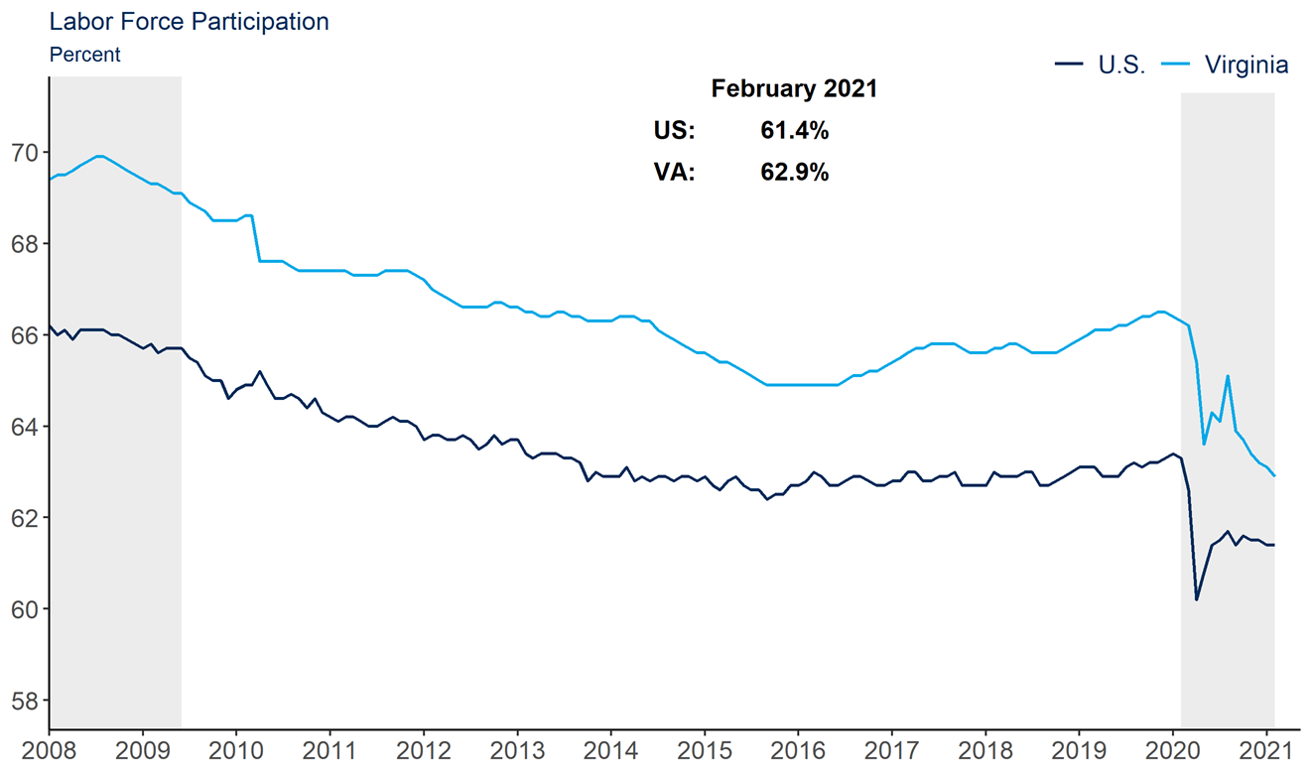
Many workers left the labor force
Source: Bureau of Labor Statistics/Haver Analytics

Slide 9
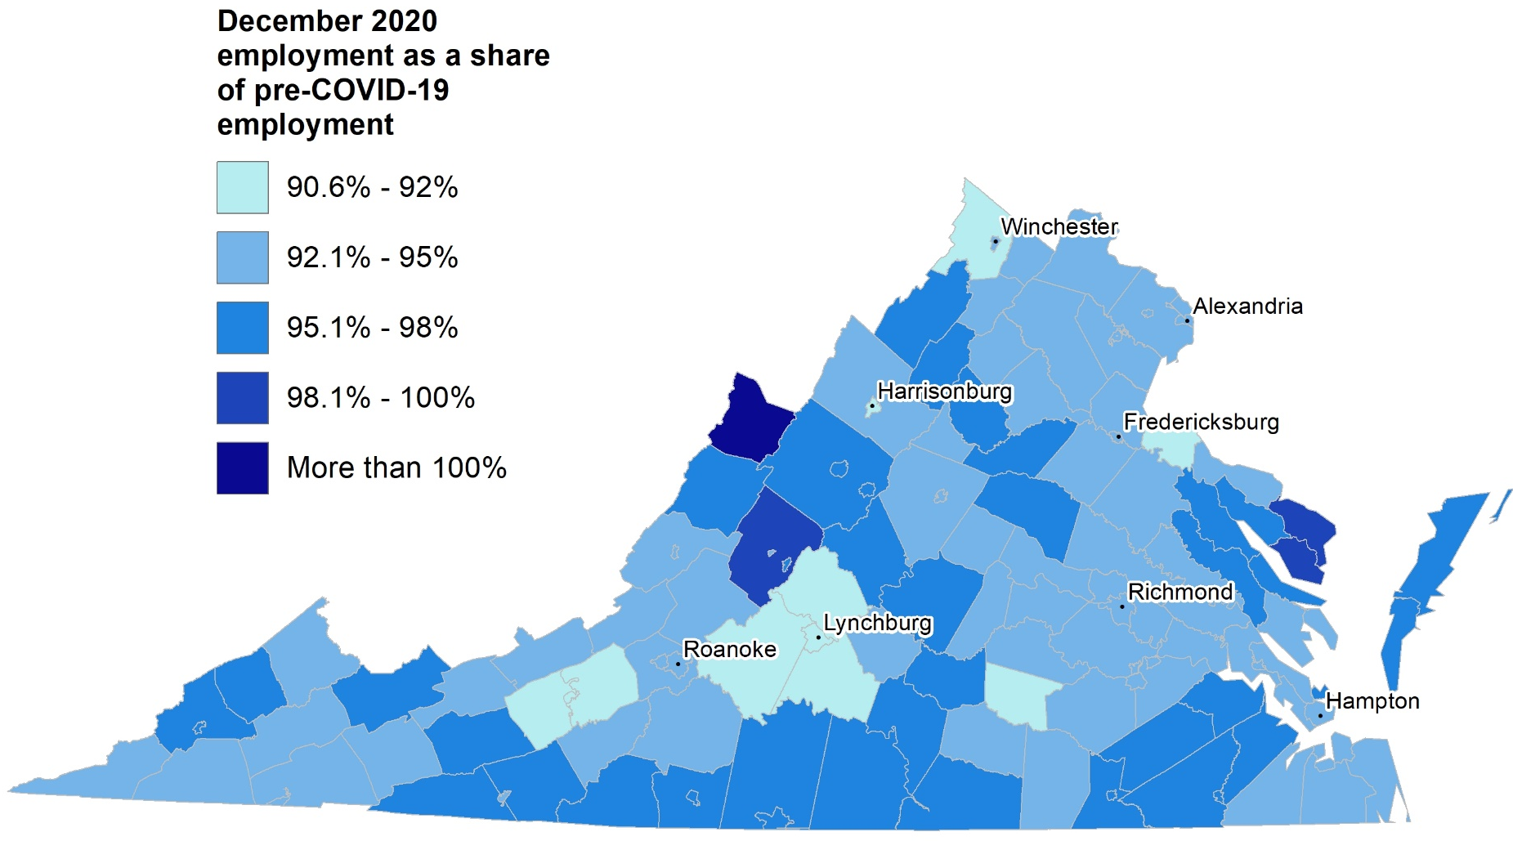
Regional disparities are large too
Source: Bureau of Labor Statistics Local Area Unemployment Statistics, Civilian Employment

Slide 10
Fiscal policy has boosted spending and saving
Month over month percent change
Dec Jan Feb
Income: 0.5 10.1 -7.1
Expenditures: -0.9 3.0 -1.2
Source: Bureau of Economic Analysis via Haver Analytics

Slide 11
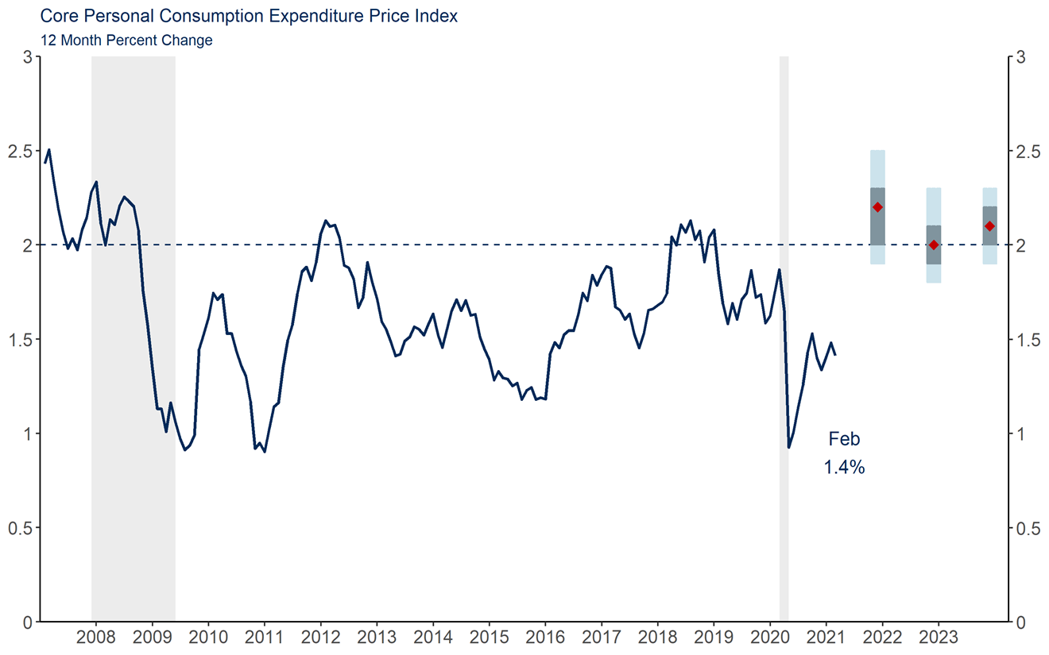
Inflation: A key thing to watch
Source: Bureau of Economic Analysis via Haver Analytics and Federal Reserve Board of Governors

Slide 12
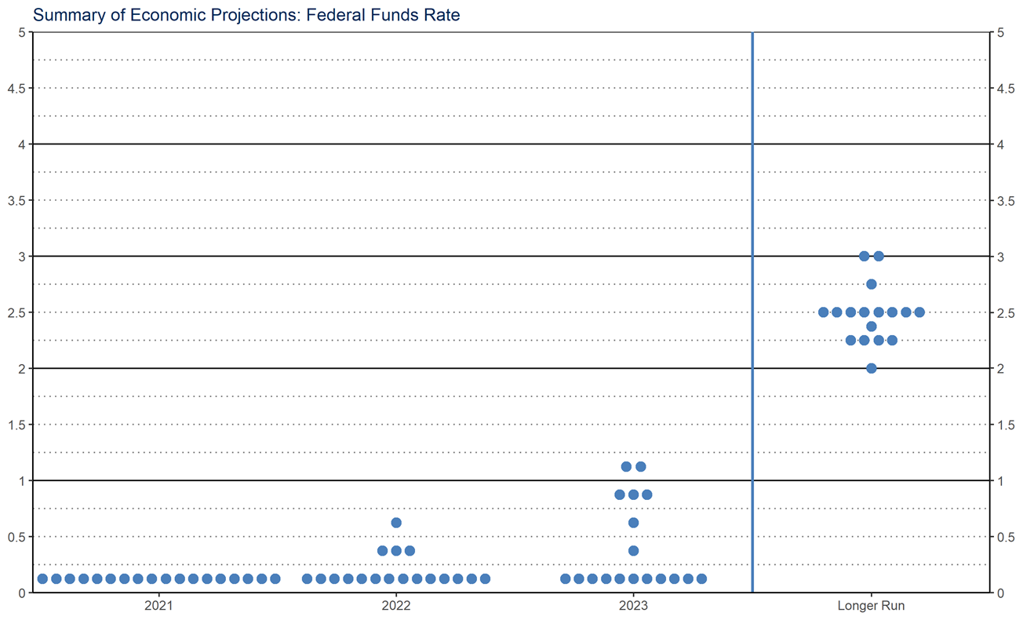
FOMC doesn’t see rates rising anytime soon
Source: Federal Reserve Board of Governors
Forecast as of March 17, 2020

Slide 13
Looking ahead into 2021
Expect a blowout Q2
Vaccine rollout, better weather, fiscal support, pent-up demand
Some bumpiness as businesses match supply/demand
Recovery not evenly felt
In-person sectors/workers still lagging
More likely to be low-wage, POC – Covid exacerbated inequalities
Re-engaging people in the workforce will be critical to minimize scarring
What I’m watching
New Covid surges (good news: vaccine bounds this risk)
Inflation (no major signs yet, but need to be vigilant)

Slide 14
Questions/Comments? renee.haltom@rich.frb.org

