Slide 1
Lead From the Heart: Transformational Leadership for the 21st Century
Presented by Steve Wright, Deputy County Administrator
For the Spring DAO Meeting-April 19, 2024

Slide 2
Lessons
Lesson 1: Why the heart matters in your leadership
Lesson 2: The importance of starting within yourself to truly lead from the heart
Lesson 3: How the heart impacts your team, and the value of strengths & purpose
Lesson 4: Why psychological safety and rapport are foundational to your efforts
Lesson 5: How to use your 1 on 1s to consistently lead from the heart
Lesson 6: Why praise matters so much
Lesson 7: The many ways to practice praise with your team, so you always know the right approach
Lesson 8: How to coach and give feedback from the heart to bring out your team's best
Lesson 9: The essential mindsets of abundance, growth, and the psychological powers
Lesson 10: How to grow everyone on your team even with limited time & budget
Lesson 11: How to hire from the heart to build an amazing team
Lesson 12: Building Lasting Loyalty & Your Legacy as a Leader

Slide 3
Lesson 1: Why the Heart Matters in Your Leadership
"The image I came up with for myself, as I marveled at my weakness [of willpower], was that I was a rider on the back of an elephant. ​​I'm holding the reins in my hands, and by pulling one way or the other I can tell the elephant to turn, to stop, or to go. I can direct things, but only when the elephant doesn't have desires of his own. When the elephant really wants to do something, I'm no match for him."
You, and every person on your team, have an elephant and a rider.
The more you can activate your elephants towards your goals, the more likely you are to accomplish them. On the other hand, if your team's emotional elephant is discouraged, depressed, or upset, it's going to be very difficult to get them to reach their goals.
Notes:
One of the funny things about how we work as humans is that we often think that we are rational. You sat down and made a rational decision or choice for the thing you did.
Yet, when we observe other people, we can often more easily see how emotional a decision really. This is a key insight that psychologist and author Jonathan Haidt uncovered in his book The Happiness Hypothesis, where he created a metaphor for our rational vs. emotional brains. As he put it:

Slide 4
Lesson 1: Why the Heart Matters in Your Leadership
What are the traits of a good leader or manager?

Slide 5
Lesson 1: Why the Heart Matters in Your Leadership
Google wanted to find out what made the most effective managers and found the following traits were essential to having a good manager:
Is a good coach
Empowers team and does not micromanage
Creates an inclusive environment, showing concern for success and well-being of each team member
Is productive and results-oriented
Is a good communicator — listens and shares information
Supports career development and discusses performance
Has a clear vision/strategy for the team
Has key technical skills/subject matter expertise to help advise the team
Collaborates across the organization
Is a strong, but inclusive decision maker

Slide 6
Lesson 1: Why the Heart Matters in Your Leadership

Slide 7
Lesson 1: Why the Heart Matters in Your Leadership

Slide 8
Lesson 1: Why the Heart Matters in Your Leadership
Notes:
And this is backed up by a 2021 American Psychological Association survey that found that 75% of the participants said the most stressful aspect of their job was interacting with their immediate boss.
"An essential question for leaders is this: How do you make other people feel? How you make others feel is what people most remember about you—even if they form this memory unconsciously—and those feelings influence behavior long after the leader is in their presence.

Slide 9
Lesson 2: To Lead from the Heart, You Must Start with Yourself
Leaders who give a lot of praise will have a team that shows gratitude and praises each other, too.
Leaders who are hard charging and have a direct communication style will have a team that is blunt and aggressive, too.
Leaders who are selfish and territorial will have a team that plays a lot of political games and fights for credit as well.
Leaders who come up with an idea-a-minute will have a nimble team that adapts to rapid changes, yet can also be easily distracted and unfocused when it comes to long term work and prioritizing.

Slide 10
Lesson 2: To Lead from the Heart, You Must Start with Yourself
“Managers who have a high need for control over people and events were 2.5 times more likely to develop heart disease by the time they were 50 years old."
Similarly, the health impacts for those attracted to power are not good, either
"...McClelland discovered that the immune systems of ‘power seekers’ were weaker than those who were more empowering.“
Yet, being controlling also has many downsides for leaders/leadership effectiveness:
You can smother your team who really want to help.
You can frustrate team members who really have a situation under control.
You can burn *a lot* of extra energy worrying about details that don't really matter.
Notes:
"Through the work of renowned researcher of human and organizational behavior Dr. David McClelland, he shows that

Slide 11
Lesson 2: To Lead from the Heart, You Must Start with Yourself
Notes:
Self-work is only useful if you plan and actually do the work to improve.

Slide 12
Lesson 3: Understanding the Hearts of Your Team
Leadership is as much about connecting with the hearts of your team as it is working together to use our rational brains to solve problems and complete tasks.
In fact, it is the balance of the rational mind and the emotional heart that brings out the best performance.
That’s why you must account for how you’re contributing to the hearts of your team and take the right actions to build them up over time.

Slide 13
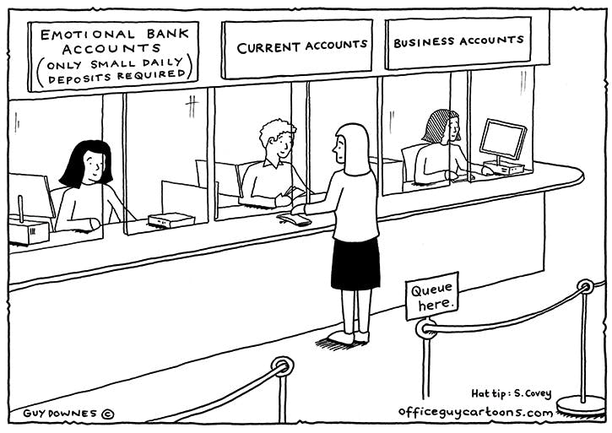
Lesson 3: Understanding the Hearts of Your Team
Are you creating emotional currency?
Notes:
This idea, which came from Stephen Covey’s classic, The 7 Habits of Highly Effective People, is a metaphor for how we account for the interactions we have with our manager. The account balance is kept by comparing 2 types of entries:
Positive leadership habits and actions make deposits. They build up good will, trust, and motivate extra effort from your team.
Tough decisions and bad habits make withdrawals. They discourage your team, and reduce your team's support for you.
Whenever you praise someone for their good work, or show kindness, fairness, patience or thoughtfulness, you are making deposits into their emotional bank account. Generally, any time someone has a positive interaction with you (which could also include via email, text, or chat), a deposit is made.
Repeated, positive interactions creates the virtuous cycle of better and better work from your team, and makes it easier to lead them (they tend to become more agreeable and helpful, too).
This is important, because you need a surplus of deposits to offset the inevitable withdrawals that will happen during tough feedback, unpopular decisions, and other natural forms of conflict that happen over time.

Slide 14
Lesson 3: Understanding the Hearts of Your Team
Employees that feel cared for = The wonder drug.
"High employee engagement and contentment are wonder drugs. They help companies retain and attract greater talent.” ​ When workers feel cared for, they invest more of themselves into their jobs. They’re inspired to serve customers better. Because their needs are being met, they instinctively put their heart into work and naturally drive greater returns—for everyone connected to the enterprise.

Slide 15
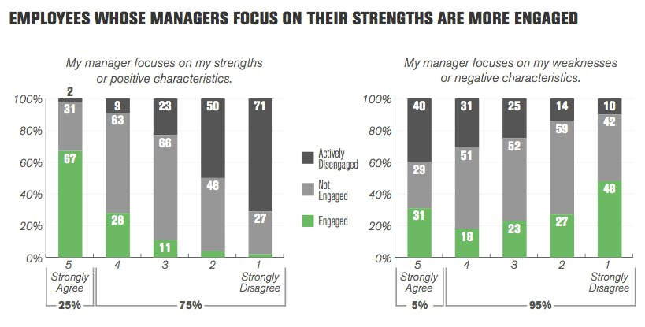
Lesson 3: Understanding the Hearts of Your Team

Slide 16
Lesson 4: How to Build a Foundation of Working Together from the Heart
In order for your team to know you care, and to build the trust you need for a high performing team, your team must specifically feel that:
You have their best interests at heart.
If they have a problem, you want to help them.
You understand what's important to them personally
It's safe to ask tough questions, deliver difficult news, and share bold ideas.
When you have bad news, or difficult feedback, you come from a place of positive intent, not attack.
When you build this kind of trust, you'll see that many other things become easier and get better with your team. They'll open up to you, help you detect problems sooner, and bring their best work to the table each day.

Slide 17
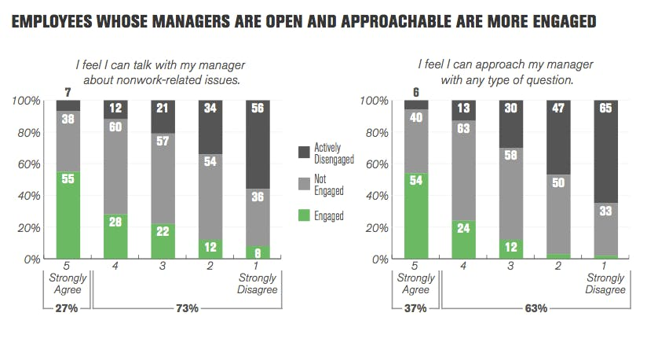
Lesson 4: How to Build a Foundation of Working Together from the Heart
Notes:
And one of the most important things a manager can do is shown in the charts above; to have a great team that thrives, you can see that the Strongly Agree group for the two key questions, "I feel I can talk with my manager about non-work related issues" and "I feel I can approach my manager with any type of question" stands far above the others in how much of their team is engaged.
That's because those are key parts of showing you care as a manager.

Slide 18
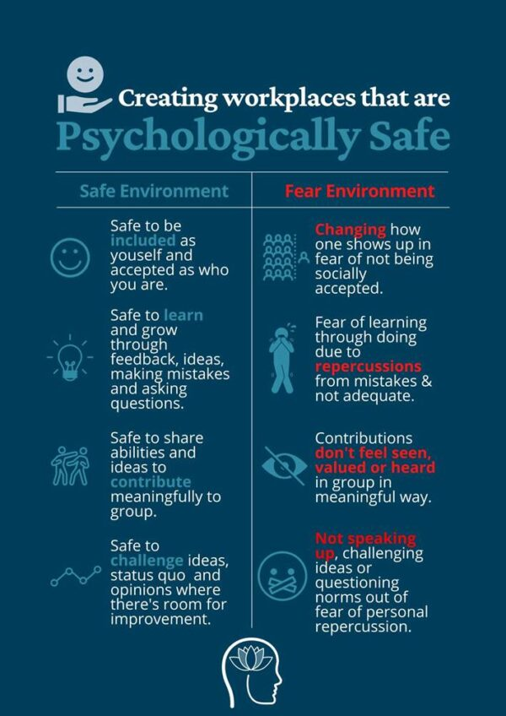
Lesson 4: How to Build a Foundation of Working Together from the Heart
The two most important ways managers show they care:
Building Rapport
Creating Psychological Safety

Slide 19
Lesson 4: How to Build a Foundation of Working Together from the Heart
Building rapport and trust is about showing you truly care.
If your team believes you care about them and you're approachable, they're much more likely to be engaged
Greater productivity and profitability
Lower turnover and absenteeism.
When you do things for your team, the power of reciprocity means they're more likely to do things you need, too.
It's easy to build a better work environment and delight your team when you take time to get to know what they're passionate and interested in, and then occasionally remember to ask about them.

Slide 20
Lesson 4: How to Build a Foundation of Working Together from the Heart
Dr. Amy Edmondson, who is a Harvard Business School professor and has studied psychological safety for decades defines psychological safety as:
“One in which people believe they can bring their full self to work. More specifically, they feel they can speak up and their ideas will be welcome, their questions will be welcome, their concerns will be welcome. It's just a place where my input is valued."

Slide 21
Psychological Safety: An Example from leadership guru Ted Lasso
Notes:
Just to set this video up a bit, Nate is currently the equipment manager for the team. He is also notoriously unconfident and accustomed to being ignored and marginalized.

Slide 22
Lesson 4: How to Build a Foundation of Working Together from the Heart
Tactic #1 for managers: Set a shared goal and establish the positive benefits of everyone speaking up.
Tactic #2 for managers: Relieve any fears and make it safe to speak up. (For example, stop anyone from criticizing ideas unjustly.)
Tactic #3 for managers: Plan ahead and be proactive in your meetings to create a great, psychological safe environment.
Tactic #4 for managers: Demonstrate that you are taking your staff’s feedback and ideas seriously.

Slide 23
Lesson 5: Using Your 1 on 1s to Consistently Lead from the Heart
Building rapport and maintaining trust-Learning about them
Giving feedback and coaching to improve their performance
Giving praise to reward and recognize great efforts
Talking about their career and planning progress
Notes:
However, you'll also want to avoid these pitfalls:
Not scheduling them: Just like we had you schedule your time to review each lesson in this program, it's important to make your 1 on 1s a recurring meeting on your calendar. Otherwise, it's too easy to miss having them for months at a time.
Wasting them on status updates: The most common mistake managers make is filling up the 30-60 minutes with talk of projects. There's plenty of other ways to get that information, but rarely other places to cover the heart-centered topics at the core of good 1 on 1s.
Not preparing for them: Spending even a few minutes thinking about a topic you want to cover, reviewing what you talked about last time, or picking out some good questions to ask makes a strong impression with your team. Completely spacing on the meeting and showing up unprepared will have the opposite effect.
Canceling them often: Emergencies happen, and people take sick days, but it should be rare to cancel 1 on 1s. Otherwise, you signal to your team that they and these meetings don't matter to you. Reschedule if you can't make it to show your team you care.
Failing to keep your promises: Nothing frustrates team members more than a manager who doesn't follow through. They will stop opening up to you if they cannot trust that when they talk to you about something that you'll keep your promises.

Slide 24
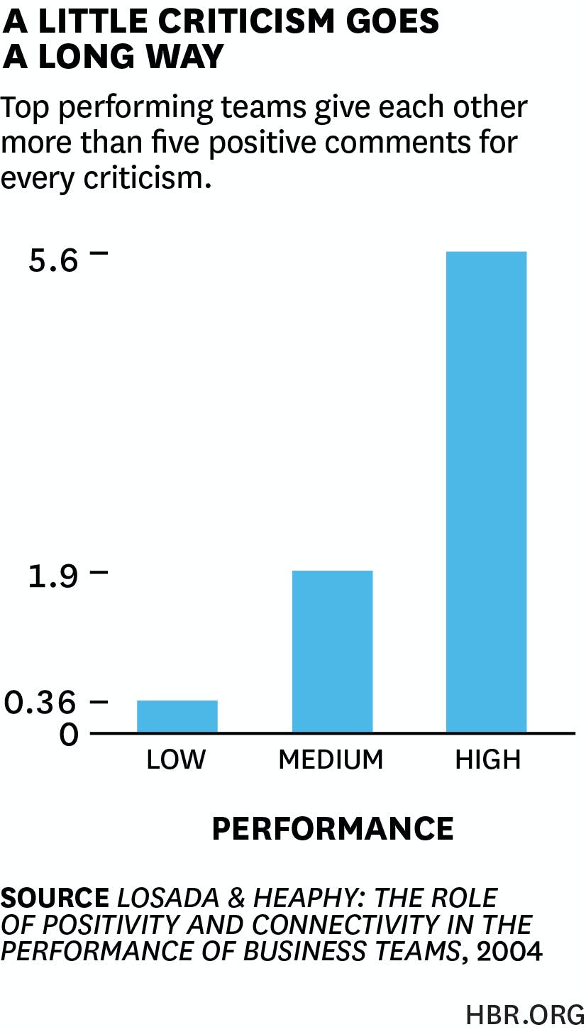
Lesson 6: The Most Powerful Leadership Practice of All​

Slide 25
Lesson 6: The Most Powerful Leadership Practice of All​
Five key habits for great recognition:
1) Give recognition when it is earned. Don’t set the bar so high, however, that only your most stellar employees will secure recognition.
2) Never ration recognition when it is earned. Give it freely.
"Not praising it is inherently harmful and choosing to ignore accomplishments in the belief that they’re an example of someone “just doing their job” is leadership malpractice.​
3) Ensure all recognition is genuine and sincere.
4) Institutionalize recognition-Make it a ritual
5) Routinely encourage people as a path to recognition
Notes:
Mark's Five Key Habits for Great Recognition
Key #1: Only give recognition when it’s earned
“The leader’s job is to hold people to high standards, proactively help them reach them, and authentically honor those whose achievements warrant it.”
As Mark reminds us, giving praise that's unearned will only damage your reputation and relationship with your team. It tells them you're really not paying attention, and makes them think they can get away with subpar work.
Key #2: Never ration recognition when it is earned.
"Not praising it is inherently harmful and choosing to ignore accomplishments in the belief that they’re an example of someone “just doing their job” is leadership malpractice.​ ​ ... Key #3: Ensure all recognition is genuine and sincere
“As long as praise is earned and deserved, acknowledging performance only has the effect of inspiring greater future effort…Disingenuous recognition can be more harmful than no recognition at all.”
Key #4: Institutionalize recognition (i.e.- Make it a ritual)
“The ideal time to honor team achievements is at the start of every month, at a team meeting where all members are present.”
In order to get to anything close to a 5 to 1 positive to negative comment ratio with your team, you're going to need to build some healthy habits around praise and recognition. When you make it a regular habit, it then becomes easier to keep that ratio high, and your team can start to anticipate when they'll receive praise (and when you might be too busy to).
Key #5: Routinely encourage people
“The power of encouragement, as an antidote to doubt and fear, is inestimable…This is not hyperbole. Words that expressed belief in me and my ability to succeed had an enormously beneficial effect.”
The three most powerful words in a leader's arsenal are, "I believe in you."
Especially when someone is still working to reach a level of earning your full throated praise and recognition, your encouragement along the way can make a tremendous difference. Yet, even for experienced team members, there can be uncertainty taking on a big or new challenge.

Slide 26
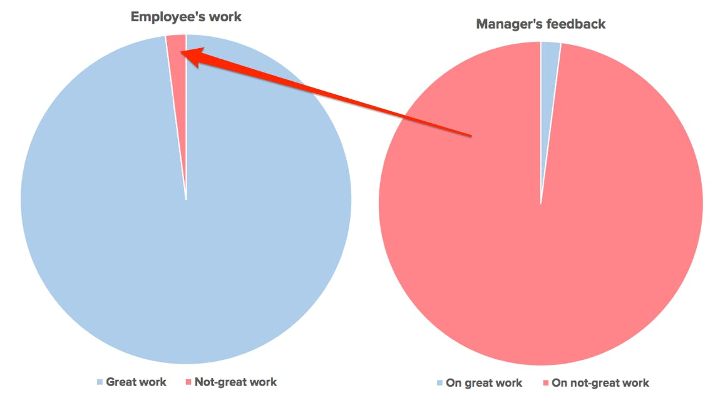
Lesson 7: The Many Ways to Practice the Most Powerful Leadership Practice with Your Team
Notes:
Taking people for granted builds resentment and disengagement.

Slide 27
Lesson 7: The Many Ways to Practice the Most Powerful Leadership Practice with Your Team
Effective ways to express praise:
A thoughtful, handwritten note
A detailed email or direct message in chat to them
Emojis, Gifs, and quick, intentional comments
In a meeting or during a group setting
Specific praise in your 1 on 1 with them

Slide 28
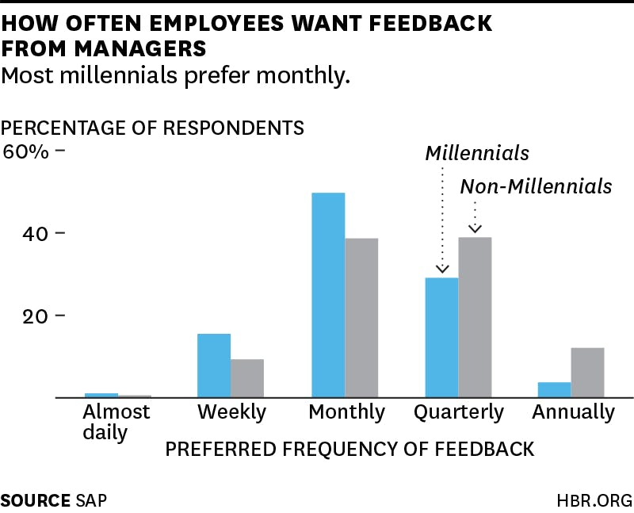
Lesson 8: How to Coach from the Heart to Bring Out Your Team's Best

Slide 29
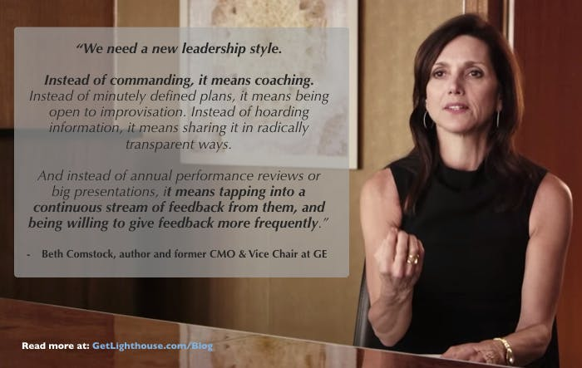
Lesson 8: How to Coach from the Heart to Bring Out Your Team's Best

Slide 30
Lesson 8: How to Coach from the Heart to Bring Out Your Team's Best
Gallup's Chief Scientist of Workplace & Wellbeing, Jim Harter:
“Coaches drive performance by being approachable human beings. They get to know people as a whole person. They discover what they’re best at, mentor their growth, and provide ongoing feedback. They’re advocates.”
An effective coaching method is Prepare-Listen-Act
Notes:
"One approach that always backfires is the use of what’s called the ‘feedback sandwich’, an ill-conceived practice where managers sandwich two pieces of praise around the one piece of criticism. “

Slide 31
Lesson 8: How to Coach from the Heart to Bring Out Your Team's Best
Prepare
To prepare well, sit down and think about the feedback you need to give your team and ask yourself:
When did this happen? What is the context?
Is this an isolated event, or has it happened repeatedly?
Why is this important? How does this affect others?
What do they need to do differently going forward to address this?

Slide 32
Lesson 8: How to Coach from the Heart to Bring Out Your Team's Best
Listen
To get their side of things, and learn about any issues that may have contributed to the issue unbeknownst to you, ask them a couple questions like:
How is (project you're going to give feedback on) going?
How do you feel your workload is right now?
What's been your main focus lately?
How are you feeling? Have you had any major changes lately?
Notes:
In each of these cases, the plan I had for each feedback discussion went out the window as soon as I learned these things, and it brought us closer as a team because I showed I cared. That's why you have to ask.

Slide 33
Lesson 8: How to Coach from the Heart to Bring Out Your Team's Best
Act
Answer their questions and ensure they fully understand the feedback you're giving them. Do they know:
What went wrong?
Why it matters and is important they change?
What exactly they need to do differently going forward?
Notes:
Be explicit and specific on what they need to do going forward - and put it in writing.

Slide 34
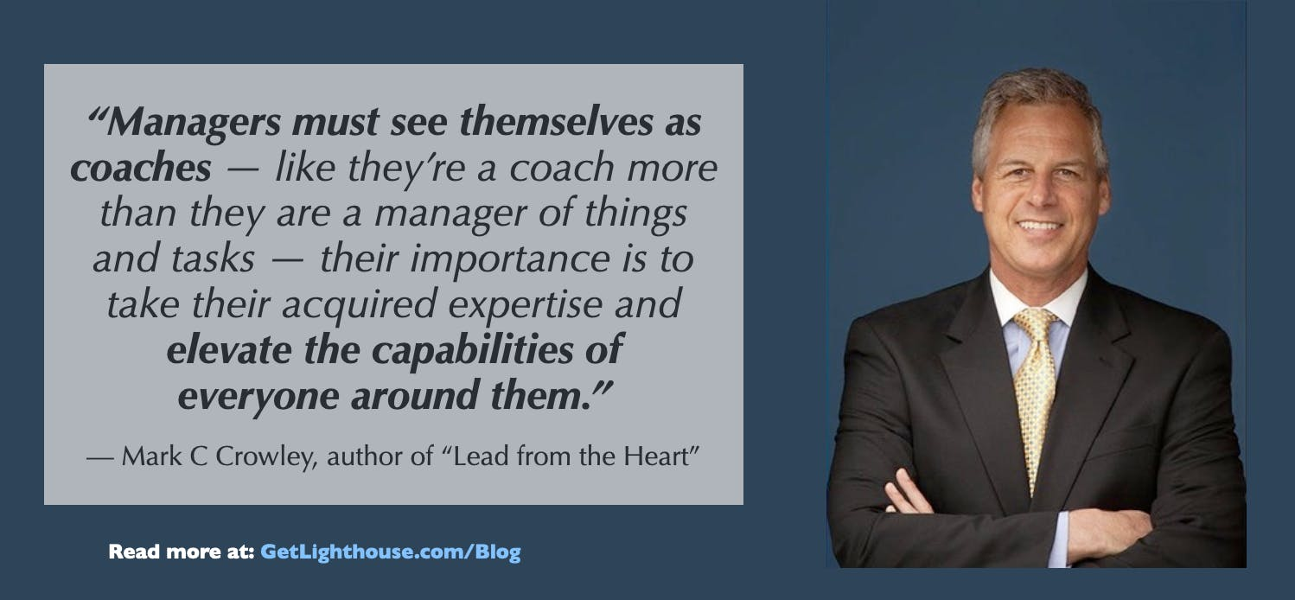
Lesson 8: How to Coach from the Heart to Bring Out Your Team's Best

Slide 35
Lesson 9: 3 Essential Mindsets You Need to Lead from the Heart
Embrace Abundance over Scarcity
At the root of this fear is a pervasive belief that we live in a world where everything is limited — a world where if another person’s light grows brighter, theirs must naturally and equivalently grow dimmer.
Tactics to Foster an Atmosphere of Abundance
Encourage your team to share credit so people don't fight over who did what. No one is diminished when multiple people contribute to a big win.
Reward effort and results, not rank. This is why *everyone* gets the ritual reward from Lesson 6, not just the top 3.
Remind your team that they can grow and learn new skills; your team is not limited to only what you have all done before.

Slide 36
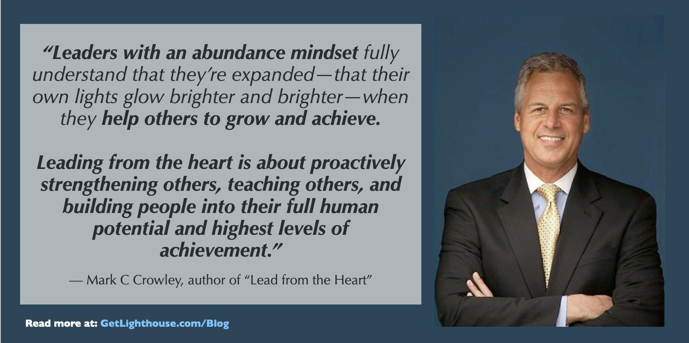
Lesson 9: 3 Essential Mindsets You Need to Lead from the Heart

Slide 37
Lesson 9: 3 Essential Mindsets You Need to Lead from the Heart
Focus on a Growth, Not Fixed Mindset
Put simply, there are two ways to look at the world:
A fixed mindset is when you believe that skills, knowledge, and abilities in an area are static, and cannot be changed.
A growth mindset is when you believe that skills, knowledge, and abilities can change over time. It's a belief in the ability to grow and develop with effort and new experiences

Slide 38
Lesson 9: 3 Essential Mindsets You Need to Lead from the Heart
Focus on a Growth, Not Fixed Mindset
Put simply, there are two ways to look at the world:
A fixed mindset is when you believe that skills, knowledge, and abilities in an area are static, and cannot be changed.
A growth mindset is when you believe that skills, knowledge, and abilities can change over time. It's a belief in the ability to grow and develop with effort and new experiences

Slide 39
Lesson 9: 3 Essential Mindsets You Need to Lead from the Heart
Applying the Growth Mindset to your Team
Do you look at your team as fixed in their skills and only give them work that they already are great at?
What do you say to your team when you hear them talk down to themselves, or suggest they'll "never" be able to do something?
Do you proactively look at your team to find opportunities to stretch and challenge them?
Do you see failure as permanent, and thus avoid areas where there were problems previously?

Slide 40
Lesson 9: 3 Essential Mindsets You Need to Lead from the Heart

Slide 41
Lesson 9: 3 Essential Mindsets You Need to Lead from the Heart
Leverage the 5 Psychological Superpowers
Prospection
Resilience
Innovation
Social Connection
Mattering
Notes:
Prospection: "Foresight. It's our ability to see ahead of change...to say that uncertainty could mean lots of things. What are some of the least likely but still potentially catastrophic or extremely positive outliers that I want to keep in mind and prepare for."
Resilience: "A skill that lets us bounce back from challenge without harm...and how do we grow stronger through challenge. How can each challenge help us develop skills?"
Innovation: "How do we develop creativity as leaders of our teams?"
Social Connection: "How do we create connection in environments that are so fast paced."
Mattering: "Our sense that what we do at work each day has some purpose...a reason to get up in the morning to fuel us to do this work to get through change."

Slide 42
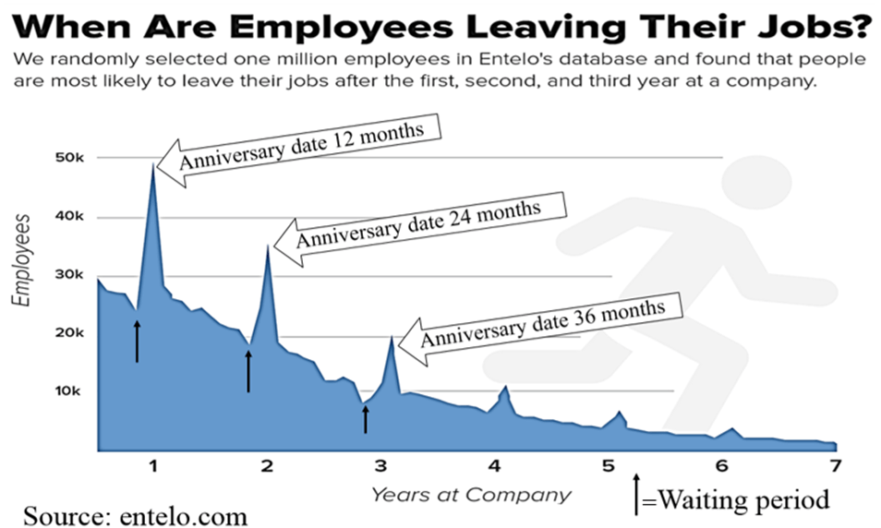
Lesson 10: Growth & Development - The Key to Motivating and Retaining Your Best People
Notes:
The chart above is from Entelo, which analyzed over 1 million LinkedIn profiles. They found that employees are much more likely to leave shortly after their work anniversaries.

Slide 43
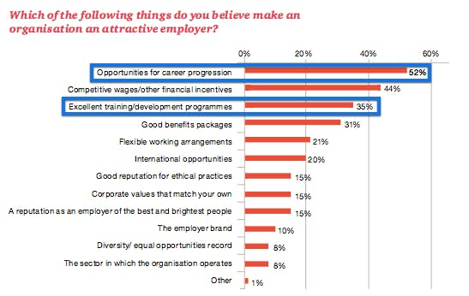
Lesson 10: Growth & Development - The Key to Motivating and Retaining Your Best People
Notes:
Study by PWC of 5,000 Millennials

Slide 44
Lesson 10: Growth & Development - The Key to Motivating and Retaining Your Best People
There are basically two scenarios you have to handle (preferably during your 1:1 sessions):
1) Starting out: When you don't know their goals (or they don't), you have to first figure out what they want to work toward.
2) Keeping momentum: Once you know their goals, you have to help them make ongoing progress to get there.

Slide 45
Lesson 10: Growth & Development - The Key to Motivating and Retaining Your Best People
Questions to Ask
What kind of success do you want in your life and what kind of success do you want in your work?
How do you feel about the progress you are making in your current role?
What specific skills would you like to grow or develop?
What are the things that I can do to help you achieve these dreams?

Slide 46
Lesson 11: How to Hire from the Heart to Build an Amazing Team
8 Key Steps to Follow for Effective Hiring Processes
1) Define and be absolutely clear on what talents you need.
2) Always seek to improve the strength and talent of your team.
3) Look for evidence of ambition and winning ways.
4) Interview with purpose. (Give your questions to the interviewees in advance.)
5) Involve your team in the selection process.
6) Obtain job samples.
7) Before you make an offer, give finalists a clear, thorough, and honest summary of your expectations and job duties.
8) Listen to your heart when making a hiring decision.
Notes:
Define and be absolutely clear on what talents you need ​
Always seek to improve the strength and talent on your team​
Look for evidence of ambition and winning ways: Personal drive and determination (sometimes called grit) often is a stronger indicator of future success than candidates who have a perfect checklist of pre-existing experience. ​ ​
Interview with purpose: No matter the questions you and your team are required to ask, make sure you ask questions about their character, ambition, persistence, and the heart to do the specific job for which you are hiring. ​
Involve your team in the selection process: Your team (especially tenured, high-performers in the role for which you’re hiring) brings valuable perspective both in evaluating skills they also possess and being a key check on culture and values fit. Make time to train them to interview well to help you. ​ ​
Obtain job samples: Nothing shows a person's ability to do a job quite like actually seeing them do it. Interviews can be misleading, but seeing actual work is a much stronger indicator. (More on this shortly...)​ ​
Before you make an offer, give finalists a clear, thorough, and honest summary of your expectations and job duties: The last thing you want to do is hire someone who then is surprised by what their day to day is really like and quits. The only way to avoid this is to be clear, up front, and detailed in what they can expect.​ ​
Listen to your heart when making a hiring decision: Your gut, and heart, are key tools in your hiring decision making process. If you have second thoughts, or a feeling they aren't the right fit, listen to it, or you may regret it like Mark did (and I have as well).

Slide 47
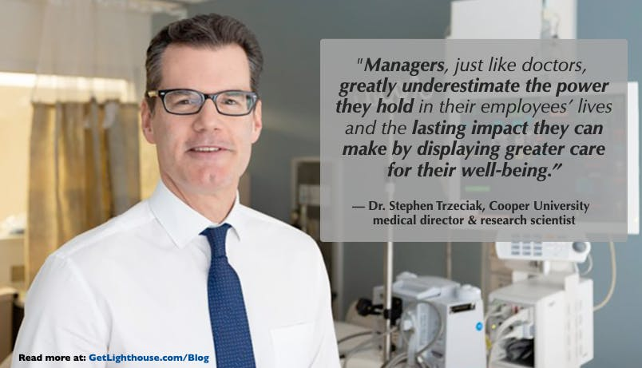
Lesson 12: Building Lasting Loyalty & Your Legacy as a Leader

Slide 48
Lesson 12: Building Lasting Loyalty & Your Legacy as a Leader
Kindness and Compassion are a strength of leadership, not a weakness.
Winning over everyone takes time...and consistency
Leading from the Heart is a lifelong way of leading, not just a momentary stop gap to improve productivity.

Slide 49
Lesson 12: Building Lasting Loyalty & Your Legacy as a Leader

